Slide 1




Write Antifragile & Domain-Driven Tests with
QA
Smoke tests Exploratory tests End-to-end tests
Outside-in diamond TDD
contract tests
Integration tests
Acceptance tests
(Coarse-grained “unit” tests)
Thomas PIERRAIN @tpierrain (υѕe caѕe drιven)
unit tests
(Fine-grained)
THOMAS PIERRAIN (@TPIERRAIN)
Notes:
Hello!
(dynamic) Hello everyone! (pause, then slowly) Hello DDD Africa! I’m very happy and truly honored to be with you tonight.
When Oliver contacted me 2 weeks ago, he asked me: « do you have something related to the code, to the tactical aspects of Domain Driven Design? »
And I said: yes, I would love to talk about something, but it will be more about TDD, than about DDD. Would you mind? He said yes, and reason why I’m here ;-)
Tests… (pause) TDD in particular, is one of my fav topic ever. It’s been a while since I started to TDD (more than 15 years now). I’ve made almost every mistake one can imagine with it:
violating encapsulation in order to test private members (don’t do that; -),
implement Fragile tests (because we’ve made tests towards implementation details. Don’t do that ;-),
duplicate production code logic in test (don’t do that),
making less baby steps than one should (don’t do that )
write too much complex tests and setups (don’t do that either), etc.
I’ve talked about TDD in conferences, I live coded publicly many times, I wrote some press articles & blog post about it but I think it’s time for me now, to talk about something that I’ve discovered like 5-4 years ago, and that gave me lots of efficiency and lot of joy at work with the various dev teams I worked with.
Outside-in Diamond is a way of doing TDD (both a workflow, and some important characteristics). We found the name with my associate Bruno Boucard. It allow us to write anti-fragile and Domain-Driven tests.
But before we dive into the topic, let me introduce myself:
My name is Thomas PIERRAIN, I’ve been building software for more than 23 years now. Doing pretty much all the job one can find in IT (and even more): dev, tech-lead, project manager, software architect, enterprise architect, coach, big brother… but I always continued to code aside even when I was involved with C-levels into more organizational topics. Doing some open source for instance. All in .NET, and almost all related to testing: testing fluent assertions with Nfluent, Fuzzers with Diverse, Smoke tests with SmokeMe and some other libraries related to tactical DDD.
I worked in many domains like the gaming industry, finance, health care, music and now in the hospitality industry since almost 2 years.
I split my weeks by managing and coding with an API dev team for an international Hotels group, and do some DDD or architecture consulting and training for other clients the rest of my time.
Last but not least, I’m practicing DDD since more than 10 years and I’m Co-organizer of the DDD meetup in France: DDD FR (you can check the videos of our community on yt, there are some really interesting things)
This evening we will talk about Outside-in TDD, we will show some code, but I finally won’t do some live-code because I did’t manage to have enough time to prepare something interesting for you. I’d rather cancel that part, and I’m truly sorry. But I’d rather do nothing than something crappy . Especially because I’ve lot of things to say before.
Hopefully we will end this session with a Q&A session all together.
Ok? let’s go!

Slide 2
Disclaimers
There is no silver bullet Your testing strategy & techniques must always be chosen accordingly to your context (both human & technical)
As long as you understand your trade-offs there is no reason not to explore new paths…
Thanks to Kent Beck, Martin Fowler, Michael Feathers, Nat Pryce & Steve Freeman for their great source of inspiration over the years #shouldersOfGiants
Notes:
I want to make a few disclaimers here. Because it’s important:

Slide 3
Preamble

Slide 4


DDD loves…
E-commerce
BFF API
d
d
Booking API
CMS API
d
U
d
U
Payment
Marketing
U
Accounts API
PSP API
Central Reservation
Loyalty API
U
CRS API
(Contextualized)
Services
U
Stay
d
d
Revenue Mgmt
d
U
Property Management System (PMS)
U
Rates & Cancellation rules API
Distribution
THOMAS PIERRAIN (@TPIERRAIN)
Resorts
Referential
Metasearch API
d
U
Hospitality
Notes:
Image : https://insights-images.thoughtworks.com/pairprogramming_f0d3ae7ef121e981e150bfcae4ecb995.jpg

Slide 5
DDD loves…
E-commerce
BFF API
d
d
Booking API
CMS API
d
U
d
U
Payment
Marketing
U
Accounts API
PSP API
Central Reservation
Loyalty API
U
CRS API
(Contextualized)
Services
U
Stay
d
d
Revenue Mgmt
d
U
Property Management System (PMS)
U
Rates & Cancellation rules API
Distribution
THOMAS PIERRAIN (@TPIERRAIN)
Resorts
Referential
Metasearch API
d
U
Hospitality
Notes:
Image : https://insights-images.thoughtworks.com/pairprogramming_f0d3ae7ef121e981e150bfcae4ecb995.jpg

Slide 6
DDD (& TDD) also loveS…
Our WeB API
HTTP
Infrastructure
Adapter
Domain
Ports & Adapters
Adapter
THOMAS PIERRAIN (@TPIERRAIN)
HTTP
API
Notes:
Image : https://insights-images.thoughtworks.com/pairprogramming_f0d3ae7ef121e981e150bfcae4ecb995.jpg

Slide 7
DDD (& TDD) also love…
Our WeB API
HTTP
Infrastructure
Easy to test
Protect Domain code from Infra fads
Quick feedback (carpaccio-style slicing)
Allow late
architectural decisions
Composable: modular-monolith ready
Adapter
Domain
Ports & Adapters
Adapter
THOMAS PIERRAIN (@TPIERRAIN)
HTTP
API
Notes:
Image : https://insights-images.thoughtworks.com/pairprogramming_f0d3ae7ef121e981e150bfcae4ecb995.jpg

Slide 8
DDD (& TDD) also love…
Domain First
Infrastructure
Adapter
Adapter
Domain
Ports & Adapters
Adapter
Adapter
THOMAS PIERRAIN (@TPIERRAIN)
Notes:
Image : https://insights-images.thoughtworks.com/pairprogramming_f0d3ae7ef121e981e150bfcae4ecb995.jpg

Slide 9
DDD (& TDD) also love…
Deploy as you wish
Our WeB API
HTTP
Infrastructure
Adapter
Domain
Ports & Adapters
Adapter
THOMAS PIERRAIN (@TPIERRAIN)
HTTP
API
Notes:
Image : https://insights-images.thoughtworks.com/pairprogramming_f0d3ae7ef121e981e150bfcae4ecb995.jpg

Slide 10
Let’s talk about tests!

Slide 11


A world of Tests
ET
Exploratory Tests (E2E)
IT
Integration Tests (Contract)
Different Types
AT
(coarse-grained unit) Acceptance Tests
THOMAS PIERRAIN (@TPIERRAIN)
UT
(fine-grained) Unit Tests

Slide 12
Why do I do TDD?

Slide 13
Made me…
Test Driven
development
Baby steps eradicate Procrastination and premature optimizations
Less debugging with Live testing tools
No regression
More relaxed
More efficient
More relevant
THOMAS PIERRAIN (@TPIERRAIN)
YAGNI ( Outside-in form )
Shared and clarified mental models
Notes:
Premature optimization: Split the make it work and the make it better
YAGNI: focus only on what really matter.
More relaxed – Against Procrastination and premature optimizations
More efficient – Progressive consolidation with baby steps
More relevant – Outside-in embraces YAGNI
Image: https://miro.medium.com/max/13440/1*o7WmwGkLVR0dVQUYqfSBeg.jpeg

Slide 14
TDD Workflows

Slide 15
Outside-in
Test Driven
development
THOMAS PIERRAIN (@TPIERRAIN)
Notes:
Image: https://miro.medium.com/max/13440/1*o7WmwGkLVR0dVQUYqfSBeg.jpeg

Slide 16
Outside-in
Test Driven
development
AT
THOMAS PIERRAIN (@TPIERRAIN)
Notes:
Image: https://miro.medium.com/max/13440/1*o7WmwGkLVR0dVQUYqfSBeg.jpeg

Slide 17
Outside-in
Test Driven
development
AT
THOMAS PIERRAIN (@TPIERRAIN)
Notes:
Image: https://miro.medium.com/max/13440/1*o7WmwGkLVR0dVQUYqfSBeg.jpeg

Slide 18
Outside-in
Test Driven
development
AT
AT
THOMAS PIERRAIN (@TPIERRAIN)
Notes:
Image: https://miro.medium.com/max/13440/1*o7WmwGkLVR0dVQUYqfSBeg.jpeg

Slide 19
Outside-in
Test Driven
development
AT
AT
AT
THOMAS PIERRAIN (@TPIERRAIN)
Notes:
Image: https://miro.medium.com/max/13440/1*o7WmwGkLVR0dVQUYqfSBeg.jpeg

Slide 20
Outside-in
Test Driven
development
AT
AT
AT
AT
THOMAS PIERRAIN (@TPIERRAIN)
Notes:
Image: https://miro.medium.com/max/13440/1*o7WmwGkLVR0dVQUYqfSBeg.jpeg

Slide 21
Outside-in
Test Driven
development
AT
AT
AT
AT
AT
THOMAS PIERRAIN (@TPIERRAIN)
Notes:
Image: https://miro.medium.com/max/13440/1*o7WmwGkLVR0dVQUYqfSBeg.jpeg

Slide 22
Outside-in
Test Driven
development
AT
AT
AT
AT
AT
AT
THOMAS PIERRAIN (@TPIERRAIN)
Notes:
Image: https://miro.medium.com/max/13440/1*o7WmwGkLVR0dVQUYqfSBeg.jpeg

Slide 23
Outside-in
Test Driven
development
AT
AT
AT
AT
AT
AT
AT
THOMAS PIERRAIN (@TPIERRAIN)
Notes:
Image: https://miro.medium.com/max/13440/1*o7WmwGkLVR0dVQUYqfSBeg.jpeg

Slide 24
Inside-out
Test Driven
development
THOMAS PIERRAIN (@TPIERRAIN)
Notes:
Image: https://miro.medium.com/max/13440/1*o7WmwGkLVR0dVQUYqfSBeg.jpeg

Slide 25
Inside-out
Test Driven
development
UT
THOMAS PIERRAIN (@TPIERRAIN)
Notes:
Image: https://miro.medium.com/max/13440/1*o7WmwGkLVR0dVQUYqfSBeg.jpeg

Slide 26
Inside-out
Test Driven
development
UT
UT
API
THOMAS PIERRAIN (@TPIERRAIN)
Notes:
Image: https://miro.medium.com/max/13440/1*o7WmwGkLVR0dVQUYqfSBeg.jpeg

Slide 27
Inside-out
Test Driven
development
UT
UT
API
UT
THOMAS PIERRAIN (@TPIERRAIN)
Notes:
Image: https://miro.medium.com/max/13440/1*o7WmwGkLVR0dVQUYqfSBeg.jpeg

Slide 28
Inside-out
Test Driven
development
UT
UT
API
UT
THOMAS PIERRAIN (@TPIERRAIN)
UT
Notes:
Image: https://miro.medium.com/max/13440/1*o7WmwGkLVR0dVQUYqfSBeg.jpeg

Slide 29
Inside-out
Test Driven
development
UT
UT
API
UT
UT
THOMAS PIERRAIN (@TPIERRAIN)
UT
Notes:
Image: https://miro.medium.com/max/13440/1*o7WmwGkLVR0dVQUYqfSBeg.jpeg

Slide 30
Inside-out
Test Driven
development
UT
UT
API
UT
UT
THOMAS PIERRAIN (@TPIERRAIN)
UT
UT
Notes:
Image: https://miro.medium.com/max/13440/1*o7WmwGkLVR0dVQUYqfSBeg.jpeg

Slide 31
Inside-out
Test Driven
development
UT
UT
API
UT
UT
THOMAS PIERRAIN (@TPIERRAIN)
UT
UT
UT
Notes:
Image: https://miro.medium.com/max/13440/1*o7WmwGkLVR0dVQUYqfSBeg.jpeg

Slide 32
Inside-out
Test Driven
development
UT
UT
AT
API
UT
UT
THOMAS PIERRAIN (@TPIERRAIN)
UT
UT
UT
Notes:
Image: https://miro.medium.com/max/13440/1*o7WmwGkLVR0dVQUYqfSBeg.jpeg

Slide 33
Inside-out
Test Driven
development
AT
UT
UT
AT
API
UT
UT
THOMAS PIERRAIN (@TPIERRAIN)
UT
UT
UT
Notes:
Image: https://miro.medium.com/max/13440/1*o7WmwGkLVR0dVQUYqfSBeg.jpeg

Slide 34
Workflows
Test Driven
development
API
…
API
…
Outside-in
Inside-out
THOMAS PIERRAIN (@TPIERRAIN)
Notes:
Image: https://miro.medium.com/max/13440/1*o7WmwGkLVR0dVQUYqfSBeg.jpeg

Slide 35
Common pitfalls & mitigations

Slide 36

Test Driven
development
When we test Implementations instead of behaviours ; - (
Because We tend to overlook some boring but crucial areas ( like adapters code )
1. Fragile tests
2. Blind spots
3. Complex setups
When ( Unit x Integration )
Test coverage is not enough
Beware of…
THOMAS PIERRAIN (@TPIERRAIN)
cognitive overload reduces stamina
and engagement
Notes:
Cognitive overload reduce stamina ➔ Pit of failure. Like a broken window syndrome.
https://www.welcometothejungle.com/en/articles/cognitive-overload-at-work
Image : https://encrypted-tbn0.gstatic.com/images?q=tbn:ANd9GcRUkEI7a62LZWV7URYcN5jClByl0GkP6ReZvA&usqp=CAU
I could have added
Non deterministic
The team must be confident in their tests
Fragile tests / Painful Refactoring
Messy test code
Slowness
Non deterministic

Slide 37
Test Driven
development
API
uses
uses
1.
Beware of… Fragile tests
Notes:
When we have situations like this

Slide 38
Test Driven
development
AT
AT
UT
API
UT
uses
UT
1.
Beware of… Fragile tests
UT
THOMAS PIERRAIN (@TPIERRAIN)
UT
UT
Notes:
When we have situations like this

Slide 39
Test Driven
development
AT
AT
UT
API
Now we want to change our implementation here
UT
uses
UT
1.
Beware of… Fragile tests
UT
THOMAS PIERRAIN (@TPIERRAIN)
UT
UT
Notes:
When we have situations like this

Slide 40
Test Driven
development
AT
AT
UT
API
UT
uses
UT
1.
Beware of… Fragile tests
UT
THOMAS PIERRAIN (@TPIERRAIN)
UT
UT

Slide 41
Test Driven
development
AT
AT
UT
😕
API
UT
😕
uses
UT
1.
Beware of… Fragile tests
😕
UT
😕
😕
😕
THOMAS PIERRAIN (@TPIERRAIN)
UT
UT

Slide 42
Test Driven
development
AT
AT
UT
😕
API
UT
😕
uses
UT
Fragile tests
➔ Less refactoring
UT
😕
😕
😕
😕
THOMAS PIERRAIN (@TPIERRAIN)
UT
UT

Slide 43
Test Driven
development
AT
AT
UT
😕
Mitigations
Do not test “implementations”
Focus on external behaviours instead (with Outside-in TDD)
Favor (coarse-grained unit) Acceptance tests over fine-grained unit tests
API
UT
😕
uses
UT
Fragile tests
AP
…
…
UT
😕
😕
😕
THOMAS PIERRAIN (@TPIERRAIN)
UT
UT
Notes:
Do not test “implementations” . Nat Pryce and Steve Freeman wrote in their tremendous GOOS book: “Unit-test Behavior, not methods”.
This has also been repeatedly said by Ian Cooper again and again (with his great talk about it named: “TDD, where did it all go wrong”)
So yes. Nothing new here. But I had to repeat it again and again myself too.

Slide 44
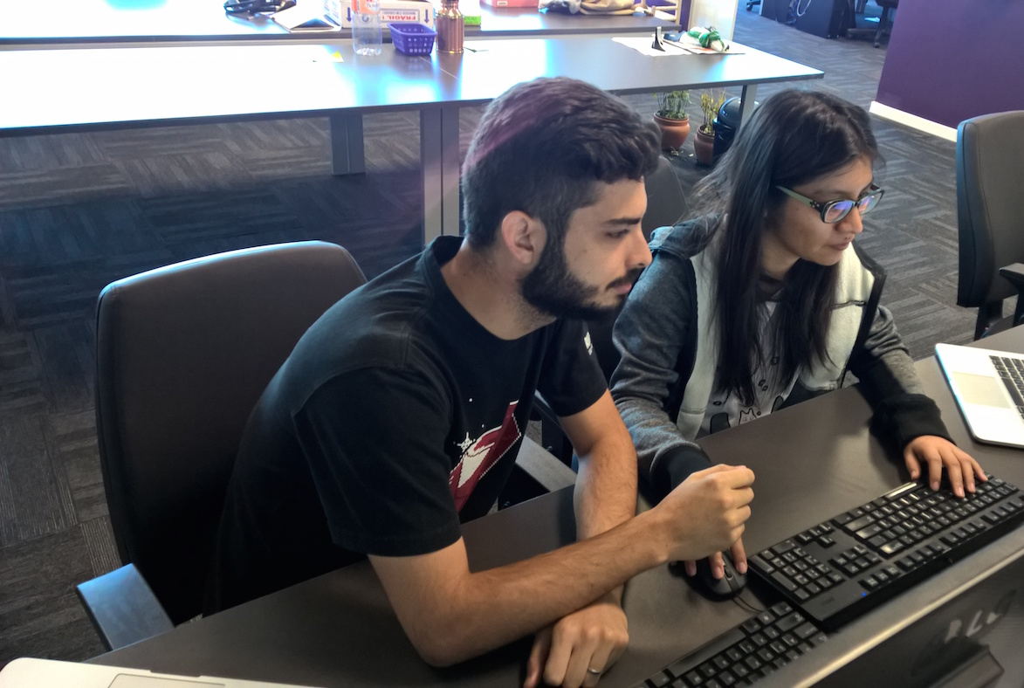
Test Driven
development
Disclaimer
Test Coverage will be a visual help to identify blind spots in our code here
It doesn’t mean that test coverage is a must
2.
Beware of… Blind Spots
THOMAS PIERRAIN (@TPIERRAIN)
Notes:
Image : https://insights-images.thoughtworks.com/pairprogramming_f0d3ae7ef121e981e150bfcae4ecb995.jpg

Slide 45
Test Driven
development
Our WeB API
HTTP
Infrastructure
Adapter
Domain
2.
Beware of… Blind Spots
Adapter
HTTP
API
THOMAS PIERRAIN (@TPIERRAIN)
Notes:
Image : https://insights-images.thoughtworks.com/pairprogramming_f0d3ae7ef121e981e150bfcae4ecb995.jpg

Slide 46
Test Driven
development
Test the domain code with { acceptance | unit tests }
Domain
2.
Beware of… Blind Spots
THOMAS PIERRAIN (@TPIERRAIN)
Notes:
Image : https://insights-images.thoughtworks.com/pairprogramming_f0d3ae7ef121e981e150bfcae4ecb995.jpg

Slide 47
Test Driven
development
Test the domain code with { acceptance | unit tests }
Adapter
Domain
2.
Beware of… Blind Spots
Adapter
HTTP
Test the infra code (i.e. Adapters) with contract (integration) tests
API
THOMAS PIERRAIN (@TPIERRAIN)
Notes:
Image : https://insights-images.thoughtworks.com/pairprogramming_f0d3ae7ef121e981e150bfcae4ecb995.jpg

Slide 48
Test Driven
development
AT
AT
AT
AT
AT
AT
AT
AT
AT
AT
AT
AT
Domain
AT
AT
AT
100% covered
by Acceptance Tests
Stub
HTTP
2.
Beware of… Blind Spots
API
Right Adapter
80%
IT
IT
IT
⬄
IT
THOMAS PIERRAIN (@TPIERRAIN)
Contract tests
Stub
Notes:
Image : https://insights-images.thoughtworks.com/pairprogramming_f0d3ae7ef121e981e150bfcae4ecb995.jpg

Slide 49

Test Driven
development
As DEV we
to write Domain-Driven tests
AT
AT
AT
AT
AT
AT
AT
AT
AT
AT
AT
AT
Domain
AT
AT
AT
100% covered
by Acceptance Tests
Stub
HTTP
2.
Beware of… Blind Spots
API
Right Adapter
80%
IT
IT
IT
⬄
IT
THOMAS PIERRAIN (@TPIERRAIN)
Contract tests
Stub
Notes:
Image : https://insights-images.thoughtworks.com/pairprogramming_f0d3ae7ef121e981e150bfcae4ecb995.jpg

Slide 50

Test Driven
development
As DEV we
to write Domain-Driven tests
AT
AT
AT
AT
AT
AT
AT
AT
AT
AT
AT
AT
Domain
AT
AT
AT
100% covered
by Acceptance Tests
Stub
HTTP
2.
Beware of… Blind Spots
API
Right Adapter
80%
BUG
BUG
IT
IT
IT
⬄
IT
THOMAS PIERRAIN (@TPIERRAIN)
Contract tests
Stub
Notes:
Image : https://insights-images.thoughtworks.com/pairprogramming_f0d3ae7ef121e981e150bfcae4ecb995.jpg

Slide 51
Test Driven
development
As DEV we
to write Domain-Driven tests
AT
AT
AT
AT
AT
AT
AT
AT
AT
AT
AT
AT
Domain
AT
AT
AT
100% covered
by Acceptance Tests
Stub
HTTP
2.
Beware of… Blind Spots
API
As DEV we don’t write enough integration tests
Because they are slow to run & boring
➔
Right Adapter
80%
BUG
BUG
IT
IT
IT
⬄
IT
THOMAS PIERRAIN (@TPIERRAIN)
Contract tests
BUGS
Stub
Notes:
Image : https://insights-images.thoughtworks.com/pairprogramming_f0d3ae7ef121e981e150bfcae4ecb995.jpg

Slide 52
Test Driven
development
As DEV we
to write Domain-Driven tests
AT
AT
AT
AT
AT
AT
AT
AT
AT
AT
AT
AT
Domain
AT
AT
AT
Mitigations
Detect bugs in Adapters via our beloved Acceptance tests
Include the Adapters code and stub only the I/Os
100% covered
by Acceptance Tests
BUGS
Stub
HTTP
Blind Spots
API
As DEV we don’t write enough integration tests
Because they are slow to run & boring
➔
Right Adapter
80%
BUG
BUG
IT
IT
IT
⬄
IT
THOMAS PIERRAIN (@TPIERRAIN)
Contract tests
BUGS
Stub
Notes:
Image : https://insights-images.thoughtworks.com/pairprogramming_f0d3ae7ef121e981e150bfcae4ecb995.jpg

Slide 53
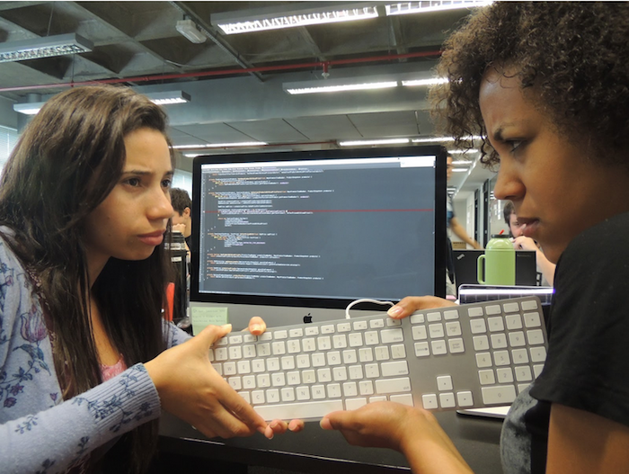
Test Driven
development
3.
Beware of… Complex setups
THOMAS PIERRAIN (@TPIERRAIN)
Notes:
Image: https://insights-images.thoughtworks.com/1020ways20pair20programming201_ac7561ab53c005c72dd42a76dcc238a9.png

Slide 54
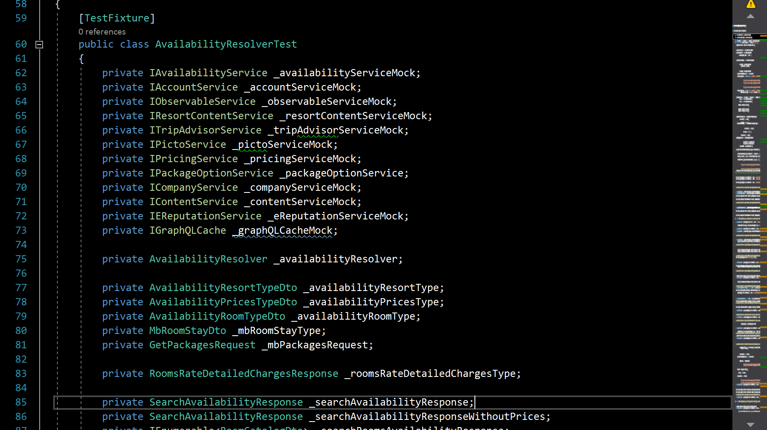
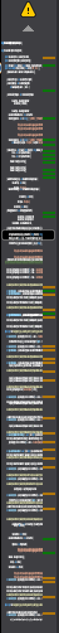
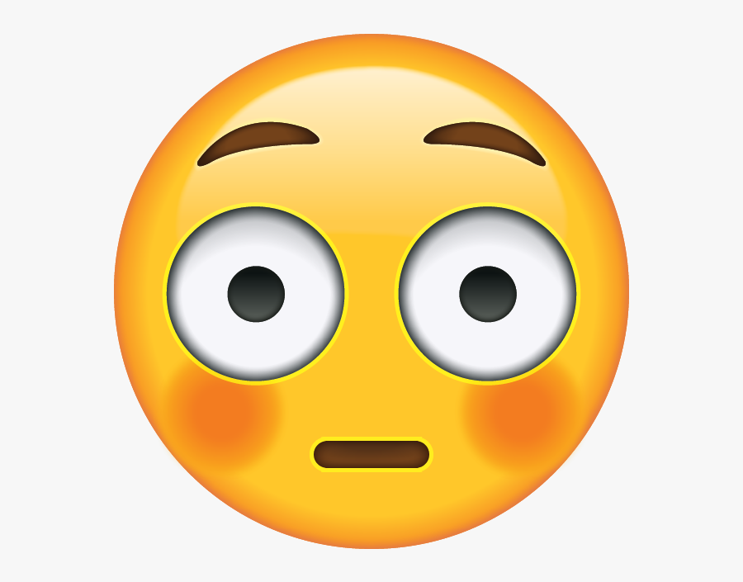
Test Driven
development
Test Suite for Rooms Availability
740 lines of Init()
3.
Beware of… Complex setups
THOMAS PIERRAIN (@TPIERRAIN)
Notes:
Image: https://insights-images.thoughtworks.com/1020ways20pair20programming201_ac7561ab53c005c72dd42a76dcc238a9.png

Slide 55
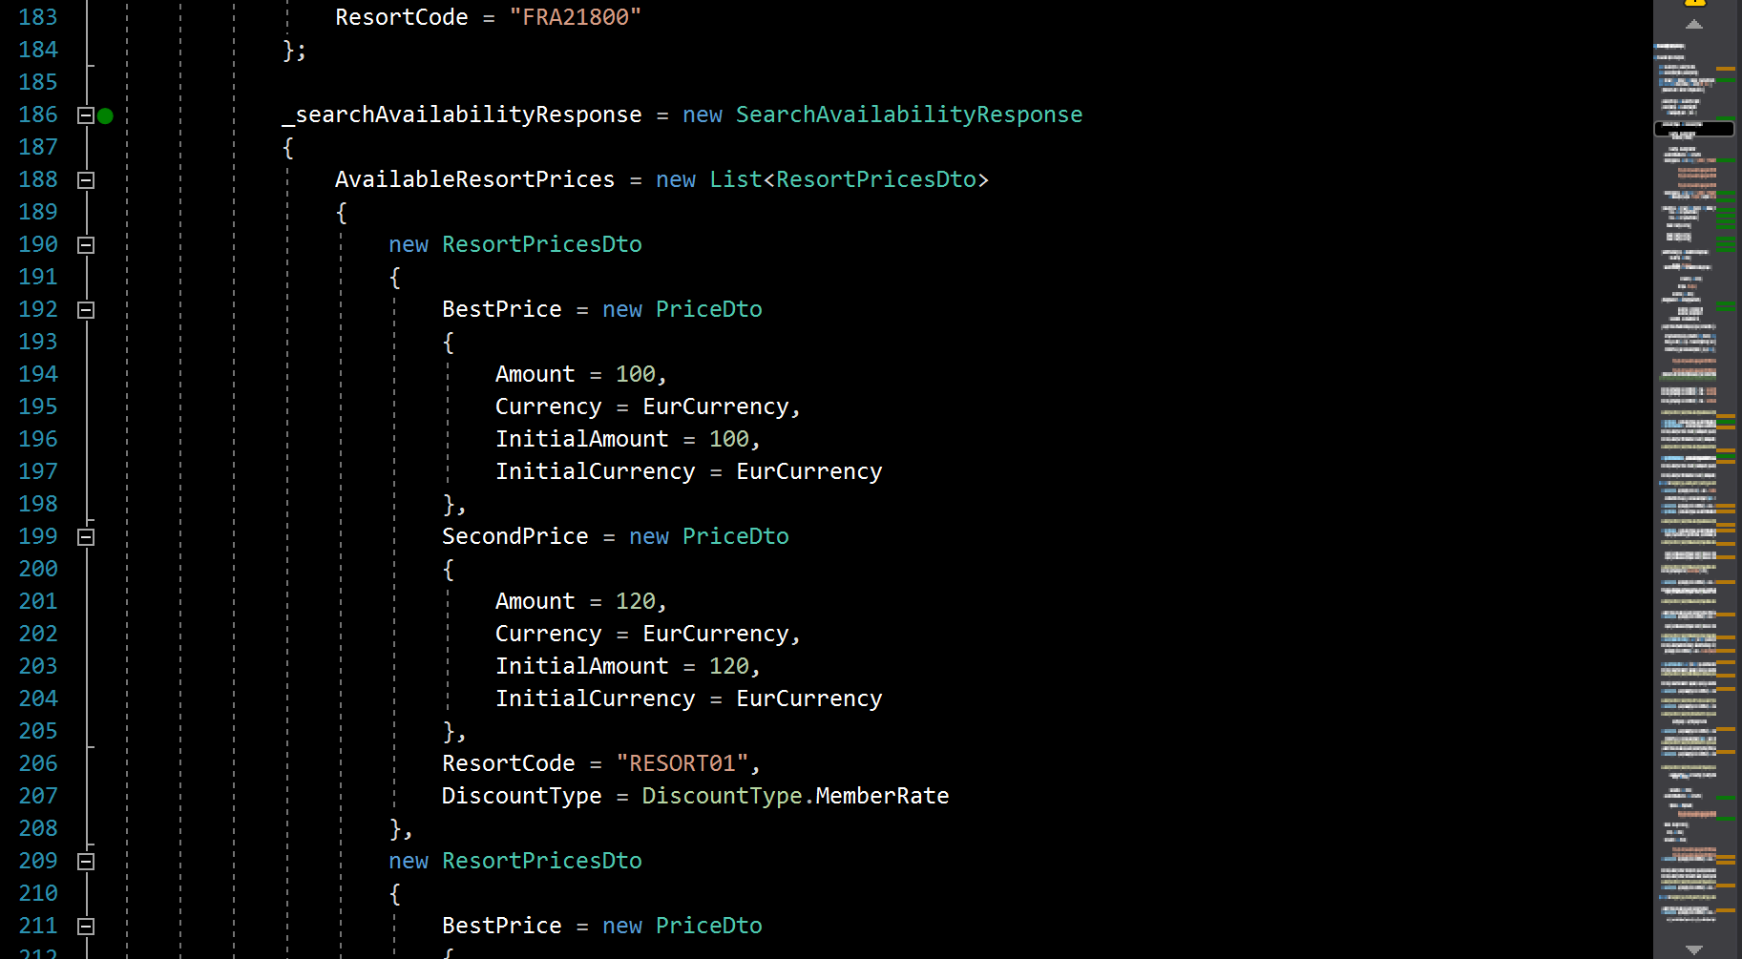
Test Driven
development
Test Suite for Rooms Availability
740 lines of Init()
3.
Beware of… Complex setups
THOMAS PIERRAIN (@TPIERRAIN)
Notes:
Image: https://insights-images.thoughtworks.com/1020ways20pair20programming201_ac7561ab53c005c72dd42a76dcc238a9.png

Slide 56
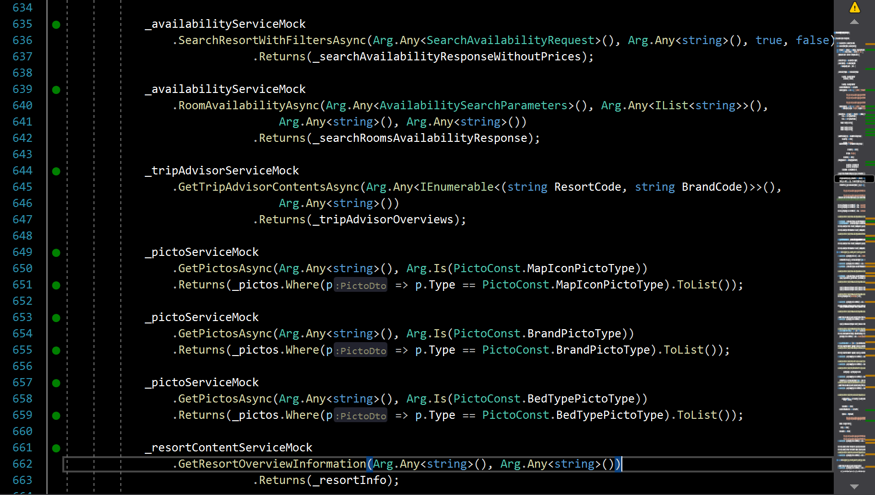
Test Driven
development
Test Suite for Rooms Availability
740 lines of Init()
3.
Beware of… Complex setups
THOMAS PIERRAIN (@TPIERRAIN)
Notes:
Image: https://insights-images.thoughtworks.com/1020ways20pair20programming201_ac7561ab53c005c72dd42a76dcc238a9.png

Slide 57
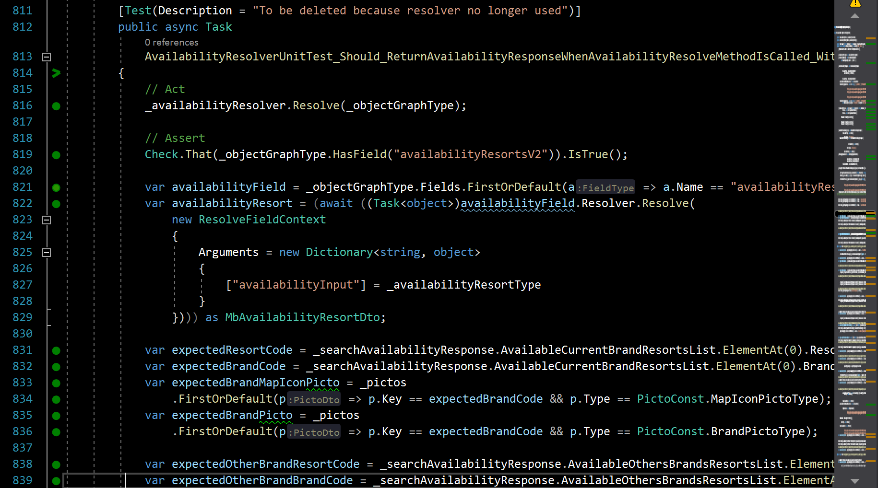

Test Driven
development
Test Suite for Rooms Availability
3.
Beware of… Complex setups
Tests using initialized fields ➔ side effects nightmare
THOMAS PIERRAIN (@TPIERRAIN)
Notes:
Image: https://insights-images.thoughtworks.com/1020ways20pair20programming201_ac7561ab53c005c72dd42a76dcc238a9.png

Slide 58

Test Driven
development
Mitigations
Avoid cognitive overload as much as possible The power of sameness
Favor local variables over test suite members Everything should be created from the test
Use Domain-Driven Builders to shorten and explicit the Arrange section of your tests
Treat your test code as production code! ➔ merciless refactoring
3.
Beware of… Complex setups
THOMAS PIERRAIN (@TPIERRAIN)
Notes:
Do not use field members, [Init], [Setup] … anything that is declared outside the test
Do not use test suites inheritance neither
Arrange – Act - Assert
Image: https://insights-images.thoughtworks.com/1020ways20pair20programming201_ac7561ab53c005c72dd42a76dcc238a9.png

Slide 59
Test Driven
development
1. Fragile tests
2. Blind spots
3. Complex setups
Beware of…
THOMAS PIERRAIN (@TPIERRAIN)
Notes:
Ok Let’s sum up all those pitfalls and risks while doing TDD. And for every one of them, the mitigations we’ve identified.
---------------------
Cognitive overload reduce stamina ➔ Pit of failure. Like a broken window syndrome.
https://www.welcometothejungle.com/en/articles/cognitive-overload-at-work
Image : https://encrypted-tbn0.gstatic.com/images?q=tbn:ANd9GcRUkEI7a62LZWV7URYcN5jClByl0GkP6ReZvA&usqp=CAU
I could have added
Non deterministic - The team must be confident in their tests
Slowness – The team must not wait more than 3-5 minutes to run all the tests

Slide 60
Test Driven
development
Do not test “implementation details”
Favor Acceptance tests (coarse-grained unit tests)
When we test Implementations instead of behaviours ; - (
1. Fragile tests
2. Blind spots
3. Complex setups
Mitigations
THOMAS PIERRAIN (@TPIERRAIN)
Notes:
First, the fragile tests. Basically, they are the consequence of badly written tests, tests that target too much the internal implementation of our components, implementation details.
Clic
So. First : do not test implementation details
And since it is easier to say than to do. Especially for beginners that stuggle a lot in order to write behaviour-driven tests with fine grained tests.
My trade-off was (see the second point here) to recommend to write more coarse grained acceptance tests, than the fine grained one.
Of course they are exceptions, but IT will take more time to explain and to discuss about it. Hence not for today (unless we have specific questions at the end of course).

Slide 61
Test Driven
development
Do not test “implementation details”
Favor Acceptance tests (coarse-grained unit tests)
When we test Implementations instead of behaviours ; - (
Because We tend to overlook some boring but crucial areas ( like adapters code )
Include the Adapters to your Acceptance tests
Test the adaptation in action
(All corner cases covered)
Stub only the I/O
(super fast tests)
1. Fragile tests
2. Blind spots
3. Complex setups
When ( Unit x Integration )
Test coverage is not enough
Mitigations
THOMAS PIERRAIN (@TPIERRAIN)
Notes:
Second issue : Blind spots in our global test harness (meaning the combination of fine grained unit tests, acceptance tests, integration/contract tests, and E2E tests in rare cases
As I could see in all the various missions, contexts, companies, teams I’d worked with: this is the consequence of a psychological bias: we, as dev, rather write domain-related tests that integration tests.
Clic
Hence the trade-off: Let’s include all these blind spots in our domain-driven Acceptance tests. Let’s test them in all our relevant actions for the business, and stub only the I/Os to keep our acceptance tests really fast. The coverage combination will be higher and the team will feel more confident with that setup (too bad for the cargo-cult coaches that still continue to think they can easily change the people and the culture instead of adapting their practices). I’ve met tons of them in my career.
“One should not do this…”, “one must not do that”…. And when your are asking why? Akward silences, before dogmatic answers.
In my opinion, our practices must remain alive, adaptable to various contexts. Anyway!

Slide 62
Test Driven
development
Do not test “implementation details”
Favor Acceptance tests (coarse-grained unit tests)
When we test Implementations instead of behaviours ; - (
Because We tend to overlook some boring but crucial areas ( like adapters code )
Include the Adapters to your Acceptance tests
Test the adaptation in action
(All corner cases covered)
Stub only the I/O
(super fast tests)
1. Fragile tests
2. Blind spots
3. Complex setups
When ( Unit x Integration )
Test coverage is not enough
Mitigations
Use Domain-Driven Builders to shorten and explicit the Arrange section of your tests
THOMAS PIERRAIN (@TPIERRAIN)
cognitive overload reduces stamina
and engagement
Notes:
Third kind of issues: complex test code, complex setups that reduce our stamina and disengage people day after day.
Clic
The trade-off is to simplify our test code and test setups, to include all the setup part in every acceptance test (to prevent from declaring stuffs elsewhere, far away in private members or fields in our test suites), but to shorten the arrange sections, the setup section of our tests with Builders.
And Domain-driven builders! talking with the language of the domain, and about concerns of the domain. Not technical concerns nor stub configuration details.
But it’s probably time for me to tell you more about all these trade-offs combined leading to the style we’ve called: Outside-in Diamond TDD!

Slide 63

Outside-in Diamond TDD
Trade offs made in reaction to people’s behaviors
(observed around us over and over and over again)
Notes:
(slowly) Outside-in Diamond TDD
Clic
Yes. Outside-in Diamond TDD is the result of some trade offs made in reaction to people’s behaviours.
It’s the consequence of many observations of people here and there in our teams and companies, and customers … over, over, and overs again.

Slide 64
Outside-in Diamond TDD
For the overall workflow we favor
For the kind of tests we favor the most
Notes:
The first part: outside in, is related to the overall workflow we favor.
Clic
The second part : Diamond is related to the kind of tests we suggest to do more: the components/the acceptance tests that are coarse grained unit tests.

Slide 65
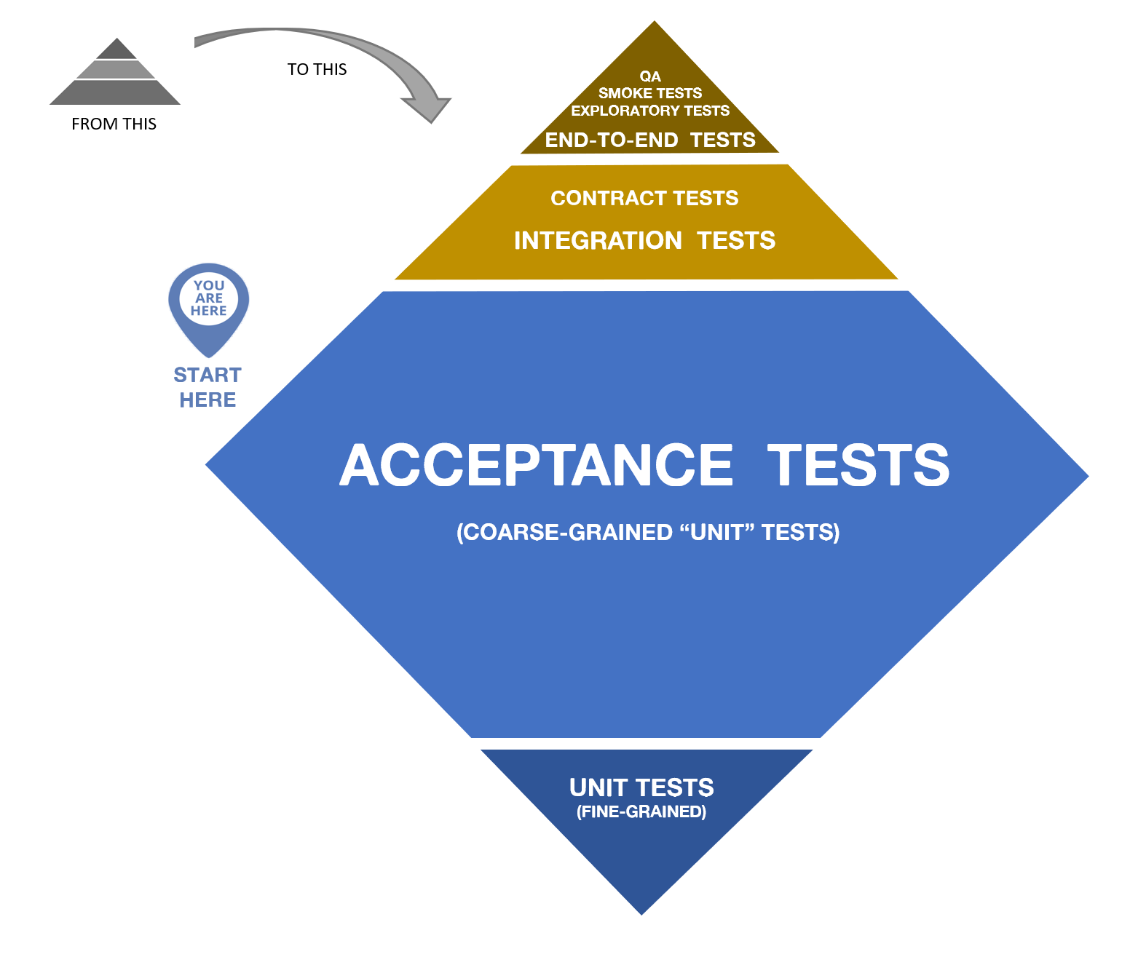
Outside-in Diamond TDD
For the overall workflow we favour
For the kind of tests we favour the most
Notes:
This is a direct reference to the test pyramid that I really don’t think was useful in the various context I worked with.
Every time, like with the word : “unit test”, it was error-prone and confusing for people (and even more experienced ones). IMO this testing pyramid –even if the idea of it is to be the starting point of a discussion about our test strategy- this pyramid should definitely be delivered with an experienced tech lead or coach aside ;-)
Anyway, we though that the diamond fits better to express the fact that we trade off to write more coase-grained acceptance tests than fine grained unit tests.
This is where comes from the diamond thing.
Actually, Outside-in Diamond TDD is a style of doing TDD. A specific workflow (mainly outside-in), a kind of double loop between the coarse grained loop and the fine grained loop, and some specificities about how to write our tests. We will see that in a couple of seconds.

Slide 66

Test Driven
development
Double loop?
Outside-in but…
THOMAS PIERRAIN (@TPIERRAIN)
Notes:
But before we have-a-look-at-the-code, let’s just focus one sec on the workflow: The way and the pace we use to write our tests.
Here I wrote “Double loop” with a question mark, because my version is slightly different than the classical “double loop”

Slide 67
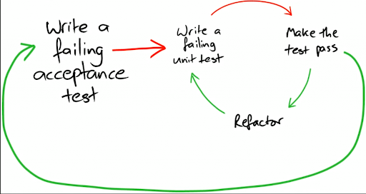
Test Driven
development
Double loop
Outside-in but…
THOMAS PIERRAIN (@TPIERRAIN)
Notes:
Here is the classic version of the double-loop.
You write a failing acceptance test towards your black-box/your system/your component/your future API whatever…
You try to make it pass by starting the implementation of the inside of your black-box, and to do so, you will start writing a fine grained unit test (then you start the inner loop with its RED-GREEN-REFACTOR, RED-GREEN-REFACTOR, RED-GREEN-REFACTOR…) until you make the original acceptance test pass. In other word, you made it green. Then…
You can refactor whatever you want or need to refactor (for instance, you improve your acceptance test code). And…
You write another acceptance test in the outer loop, before you continue within the inner loop by writing the fine-grained unit test you need to continue to implement it.
Ok?

Slide 68
Test Driven
development
(
)
Double loop
One and a half loop
Outside-in but…
THOMAS PIERRAIN (@TPIERRAIN)
Notes:
Will still have debates about it with my associate Bruno BOUCARD (which is a hell of a tech coach) but…
My version is pretty much not a double loop anymore. It’s rather something like a “One-and-a-half-loop” ;-)
It means that I do not always write fine grained unit tests, it will depend on the context and the situation. In other word: every time I face a difficulty, or every time as a pair or as a mob we think it worth to jump into that inner loop => we do it.
But there is a huge disclaimer with this:
I can do this because I’m practicing TDD at work since more than fifteen years.
We can do this with my mates because we have lots of discussions with the domain experts or domain proxy. Even if our understanding and our code will continue to evolve day after day (renaming things on the fly whenever we can), We already have some kind of shared mental model of what to do, and we discuss also a lot on how to do it (with strong style pairing where the one having the idea is not the one having the keyboard )
But when I’m coaching or teaching TDD to beginners, we do a real double loop.
Ok! That’s it for the workflow. Let’s see how our acceptance tests look like!

Slide 69
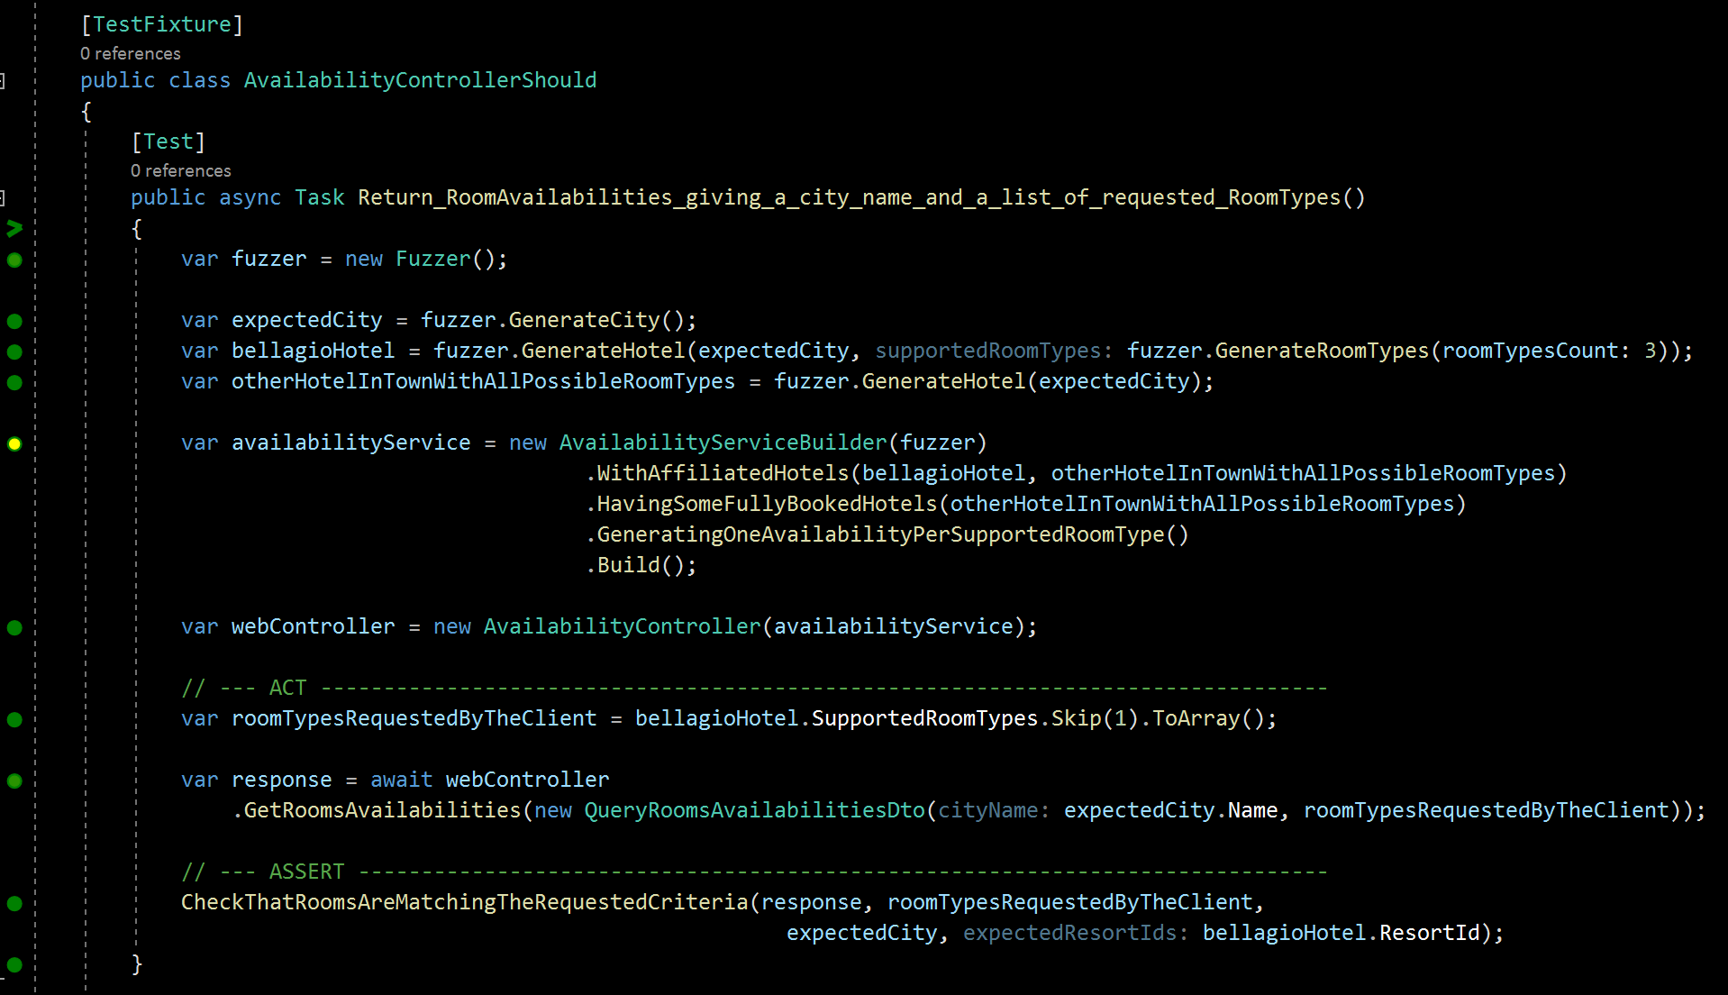
Outside-in diamond
Notes:
Silence. It’s alright if you can’t see the code right now, because I will help you to navigate with me line after line.

Slide 70
Outside-in diamond
Notes:
It all start with a test suite, here a test fixture in C# (with Nunit)

Slide 71
Outside-in diamond
+
Read it as a sentence divided into 2 parts
Notes:
An important step is to know what we want our system to do. To find a test name.
And here, I’m following the “should” convention. I think first time I’ve seen that was from Sandro Mancuso in London.
So. (pause) read it like a sentence starting at the test suite name (AvailabilityControllerShould) followed by the name of the test method. here:
“Return room availailabilities giving a city name and a list of requested room types()
A room type is something like : standard room, double room, family suite etc.

Slide 72
Outside-in diamond
Fuzzers help us - to randomly detect hard-coded values or unsupported cases
Notes:
Then we use fuzzers of random values generators. Here with the Diverse library for .Net
Fuzzers helps us to :
- Randomly detect hard-coded values or unsupported cases

Slide 73
Outside-in diamond
Fuzzers help us - to randomly detect hard-coded values or unsupported case
- to shorten our test setup
Notes:
But they also help us to shorten our test setup, the arrange part of the test.
For instance here in 1 line only, I can create a specification for an hotel, the Bellagio hotel, and specify the RoomTypes it must have
(here, the GenerateRoomTypes method allows us to randomly pick 3 different room types from my domain possible values)

Slide 74
Outside-in diamond
Builders allow Behavioral & Domain-Driven intentions (no tech details here)
Notes:
Then we use to rely on builders (see the builder pattern) in order to declare what we need to setup for this test.
These builders must be Domain-driven (in other words, they are using the ubiquitous language of our domain experts in order to express domain intentions only. Not technical)
How does it look like? Here, we want…

Slide 75
Outside-in diamond
Builders allow Behavioral & Domain-Driven intentions (no tech details here)
Notes:
To work with 2 affiliated hotels. I’m working for an international group having tons of hotels from various brands and policies etc.
The 2 hotels are described via the hotel specifications I’ve created just before with my fuzzer: the Bellagio hotel variable and the other-Hotel-in-town-with-all-possible-room-types.)

Slide 76
Outside-in diamond
Builders allow Behavioral & Domain-Driven intentions (no tech details here)
Notes:
Then I explain to my builder that I would like to have one fully-booked hotel (the one named “otherHotelInTownWithAllPossibleRoomTypes”).
Hence I will be able to check after, that no availability must be suggested from this fully booked hotel (we should only have availabilities from the available hotels, here the Bellagio hotel)

Slide 77
Outside-in diamond
Builders allow Behavioral & Domain-Driven intentions (no tech details here)
Notes:
Then we ask our builder to setup all the stubs/test doubles/etc we need for this test so that we simulate a situation where we should have “1 availability per supported room type for every hotel”
One room available for every room types supported by the various hotels. Of course, not if they are already fully booked.

Slide 78
Outside-in diamond
Builders allow Behavioral & Domain-Driven intentions (no tech details here)
Notes:
And finally we build our Availability service. The one that is doing the domain logic,
The “availability service” that exposes and implement a left-side port (of our hexagonal architecture for instance).
This portion of domain logic that we will inject to our web controller (the wb controller being our left-side adapter).

Slide 79
Outside-in diamond
Very important!
Builders allow Behavioral & Domain-Driven intentions (no tech details here)
Notes:
…Very important for both our future refactorings but also for the sake of readability:
We should never, ever, never ;-) put some technical details in our builder domain specific language. Only domain-driven intentions and expected behaviours.
One should not talking about stubs and stubbing details here, on the public side of the builder. But of course, the Build() method internally, will instantiates our various stubs whenever needed (internally using some substitute libraries like Nsubstitute, or Mockito in Java or… whatever your platform, you should find it).

Slide 80
Outside-in diamond
Injecting the result of our builder
We test from the left-side Adapter (here a web controller)
Notes:
Then we can instantiate our subject under test (the SUT), which is the AvailabilityController (web controller variable)
Because targeting the web controller level in our test, helps us to cover all its adapting code. And remember, we don’t test the network here! Only the adaptation code (from JSON, DTOs to domain one and vice versa when we need our API to return an answer)
Click (next slide)
Here we inject the result of our builder to this web controller (left side adapter)

Slide 81
Outside-in diamond
We define the end-user request
No I/O here, but we test the whole { black-box / component / API }
Notes:
We then define the end-user request. Here something like: “as a customer, I want to know what availability you will have for me and a bunch of room types (e.g.: Single room, double room, family suite etc)”
Click (next animation)
Important here: no network, no I/O. Even if we want to test the full black box, our API, our component. We want our Acceptance tests to be as fast as possible (between 5 and 200 milliseconds max for every acceptance test).

Slide 82
Outside-in diamond
Helper method to sum-up in “one line” our assert intention
Notes:
Last but not least: the assertion.
Instead of exposing all the DTOs and checks on our technical types for the answer, we hide them behind a one-liner Domain-driven intention.
A private private test or extension method.
The CheckThatRoomsAreMatchingTheRequestedCriteria method of my test suite, my test fixture.

Slide 83
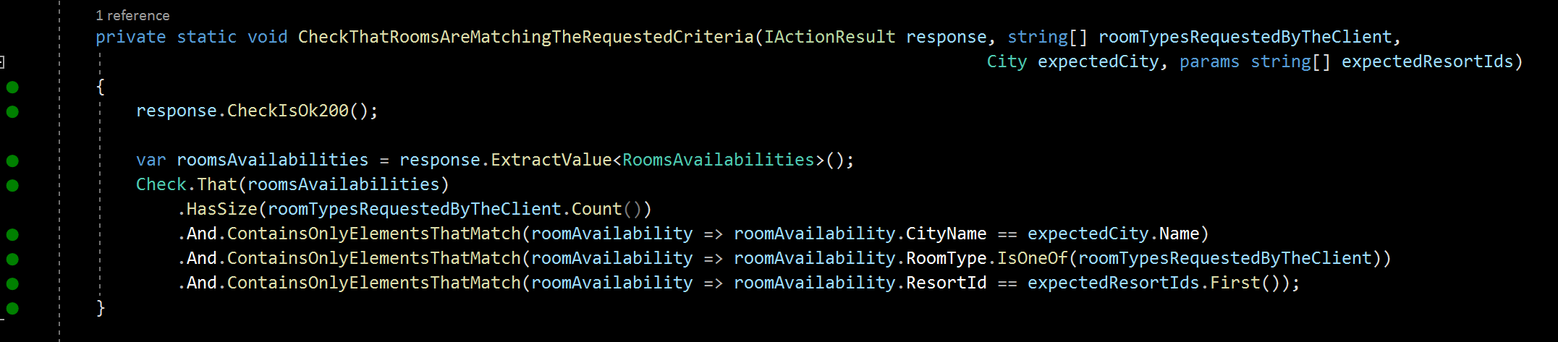
Outside-in diamond
“One line” to hide our technical assertions towards DTOs etc.
Notes:
This one-line invocation help us to hide the checking implementation.
Here we can hide the fact that we are checking the kind of HttpResponse we are supposed to get (here 200 http status code)
It also helps us to hide all the checks/assertions we make on the DTO returned by our web controller as the answer.

Slide 84
Outside-in diamond
“One line” to hide our technical assertions towards DTOs etc.
“One line” to reuse the same check intention, but with various adapters
Notes:
Having this private helper method that encapsulates all the infrastructure details behind it… has also a very interesting side-effect…
Click
=> It allows us to reuse the very same assertion intention (expressed in the domain language), so that we can implement it differently if we have different left-side adapters (if we have this requirement).
I mean: the requirement of having to switch the exposition models and technologies for your service (either through a web API, a message-oriented bus, etc. But on my side, we usually exposes our services through web APIs. So…)
But once again, “encapsulate change” (from the OOP world) is a good advice.

Slide 85
Outside-in diamond
Notes:
Ok. To sum-up

Slide 86
Outside-in diamond
Notes:
First we have the Arrange part of the test. Should not take more than 8-10 lines

Slide 87
Outside-in diamond
Notes:
Then we have the “ACT” section of our test which is targeting left-side adapters (here a web controller).
2 lines here
One can even hide the DTO declaration behind a single test private method that will do the job.
It can be really helpful for people having to test more than one left side adapter as we just mentioned earlier in the previous slide.
So Action between 1 or 2 lines

Slide 88
Outside-in diamond
Notes:
And finally we have the Assert section of our Acceptance test.
Here: 1 line
And then here again, you can “eat your cake and have it too” (meaning: you can have a Domain-driven assertion without any specific details about your DTOs and infrastructure adaptations, but nonetheless testing them in order to avoid bugs in production related to any kind of Adapters).
To do so, all you have to is to hide our assertions behind a private method that will express your assert intention. Here I could have found a better example of a domain-driven name... but I hope you can get my point.

Slide 89
Outside-in diamond
Notes:
Here is the full test

Slide 90
Outside-in diamond
Arrange
ACT
Assert
Notes:
With its 3 A-A-A sections highlighted :
ARRANGE
Click
ACT
=> Click
ASSERT

Slide 91
Outside-in diamond
Fuzzers to shorten & speed setup
Arrange
Builders to shorten and “domain-driven” our test setup
ACT
Assert
Notes:
And 2 things to keep in mind: use fuzzers & use builders
They will allow you to:
shorten your tests
speed up their writing
improve your bug detection
Make them less fragile, because less connected to your implementation
Foster Domain-driven expressivity

Slide 92
Outside-in diamond
Domain-Driven!
Notes:
And 2 things to keep in mind: use fuzzers & use builders
They will allow you to:
shorten your tests
speed up their writing
improve your bug detection
Make them less fragile, because less connected to your implementation
Foster Domain-driven expressivity

Slide 93
Live code

Slide 94
Wrap up
Notes:
Ok, final wrap-up!

Slide 95
Outside-in Diamond TDD
Thomas PIERRAIN @tpierrain (υѕe caѕe drιven)
Elaborated from & for the people
Write fast & Antifragile tests ( refactoring )
DDD but covers more blind spots on the tech side
Notes:
To conclude
Clic
It has been elaborated from and for the people we were working with during the last decade or so. ➔ clic
It allows us to write fast and antifragile tests. Meaning: tests that fully embrace your merciless refactoring sessions. You need to change something in your implementation? The impact will stay at the builder level, in factorized code. It’s very unlikely that you need to change lots of tests. ➔ clic
It Allows us to fully embrace Domain Driven Design (especially the ubiquitous language part) in our tests, but – and it’s a key point: it allows us to catch lots of tiny bugs that are located in boaring code (the one doing the adaptations in all our possible combination) ➔ the left and right-side Adapters of our hexagonal architecture APIs
➔ clic

Slide 96
Outside-in Diamond TDD
Thomas PIERRAIN @tpierrain (υѕe caѕe drιven)
Elaborated from & for the people
Write fast & Antifragile tests ( refactoring )
DDD but covers more blind spots on the tech side
Notes:
So I would love to have your feedback and questions about it. Right now. But also through twitter where you can reach me with the twitter handle here on screen
It’s just the beginning for me to talk about this topic. I will continue to explain what it is in the upcoming weeks through real live coding sessions this time, and maybe videos in order to clarify the whole process, the workflow, the decisions, the design, etc.

Slide 97
Any Questions?
Notes:
Ok. Do we still have some time for some questions?
Do you have any questions?
I don’t know how Oliver and Cherif would like to do this. But I’m ok to continue to discuss it about it if it’s possible for you.
---------------------------------
Common objections
Combinatory explosion of test cases?!? ➔lots of concise & easy to write acceptance tests (powered by fuzzers) were more than sufficient in 85% of my experience
Surgical identification of bug spots?!? ➔ no big deal actually. very episodically, You just debug your reproductible acceptance test and… TADA! (this point was just cargo-cult psychological barrier)

Slide 98
Binary is for machine Code is for people We care people
Special thanks to: Bruno BOUCARD, Cyrille DUPUYDAUBY & Rui CARVALHO for their kind reviews & feedbacks

Slide 99
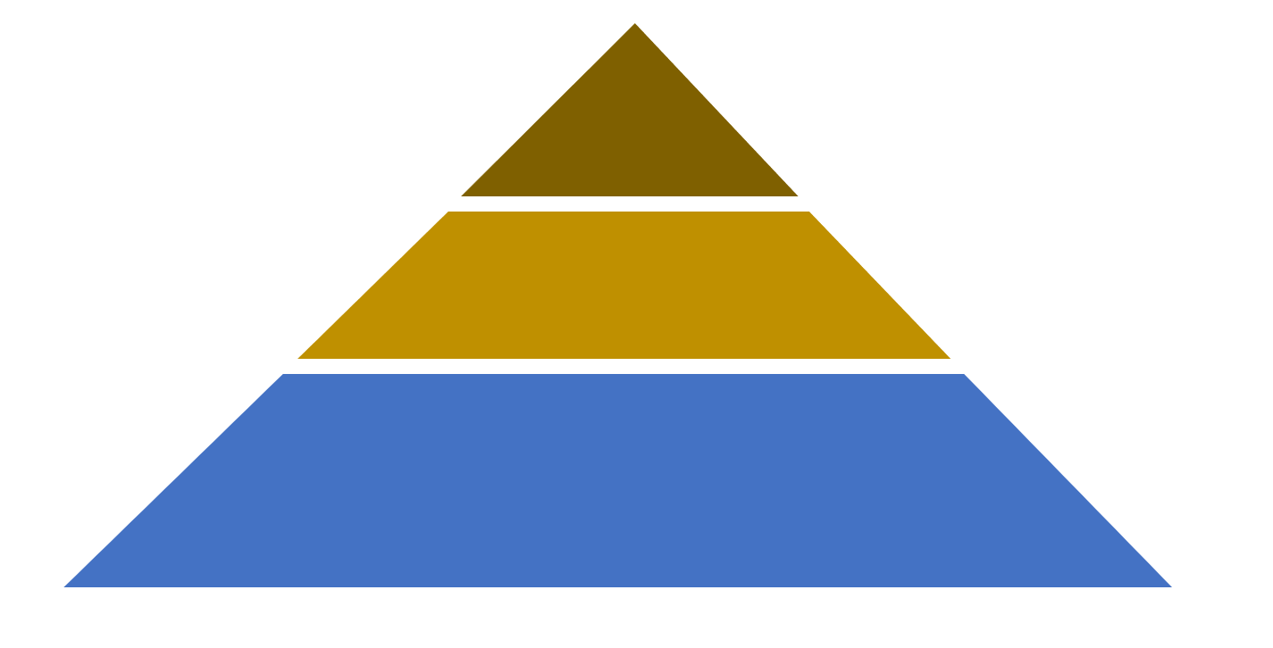

To this
QA
Smoke tests Exploratory tests End-to-end tests
From this
contract tests
Integration tests
Start Here
Acceptance tests
(Coarse-grained “unit” tests)
unit tests
(Fine-grained)

Slide 100

Checking In real life…
All real systems involved May be Manual sometimes
To this
QA
Smoke tests Exploratory tests End-to-end tests
From this
contract tests
Integration tests
Are we still compliant with…?
Some real systems involved
Ensure that Stubs ⬄ Real systems
It all starts here…
Outside-in TDD
Behavioural & Domain-Driven
Bloody Fast
Autonomous & Concise (builders & Fuzzers to setup)
NO I/O ➔ “last miles” stubs
Deterministic & Isolated
The outer loop
Start Here
Acceptance tests
(Coarse-grained “unit” tests)
unit tests
(Fine-grained)
For complex parts only
Behavioural & Domain-Driven
Bloody Fast
Deterministic & Isolated
The inner (optional) loop
testing gem: Why outside-in diamond is now our favorite testing strategy @

Slide 101
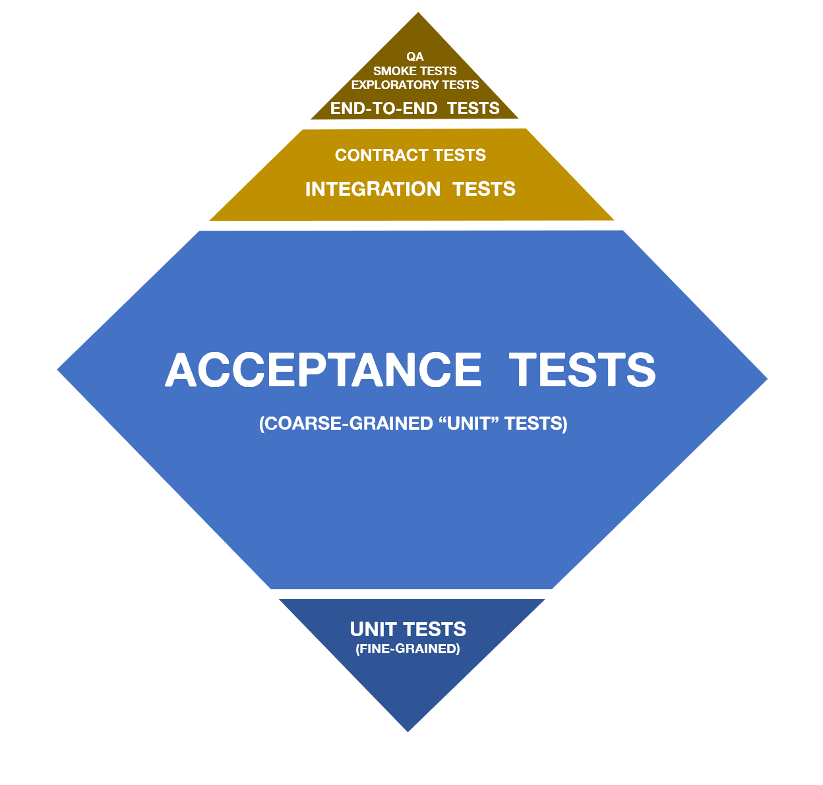
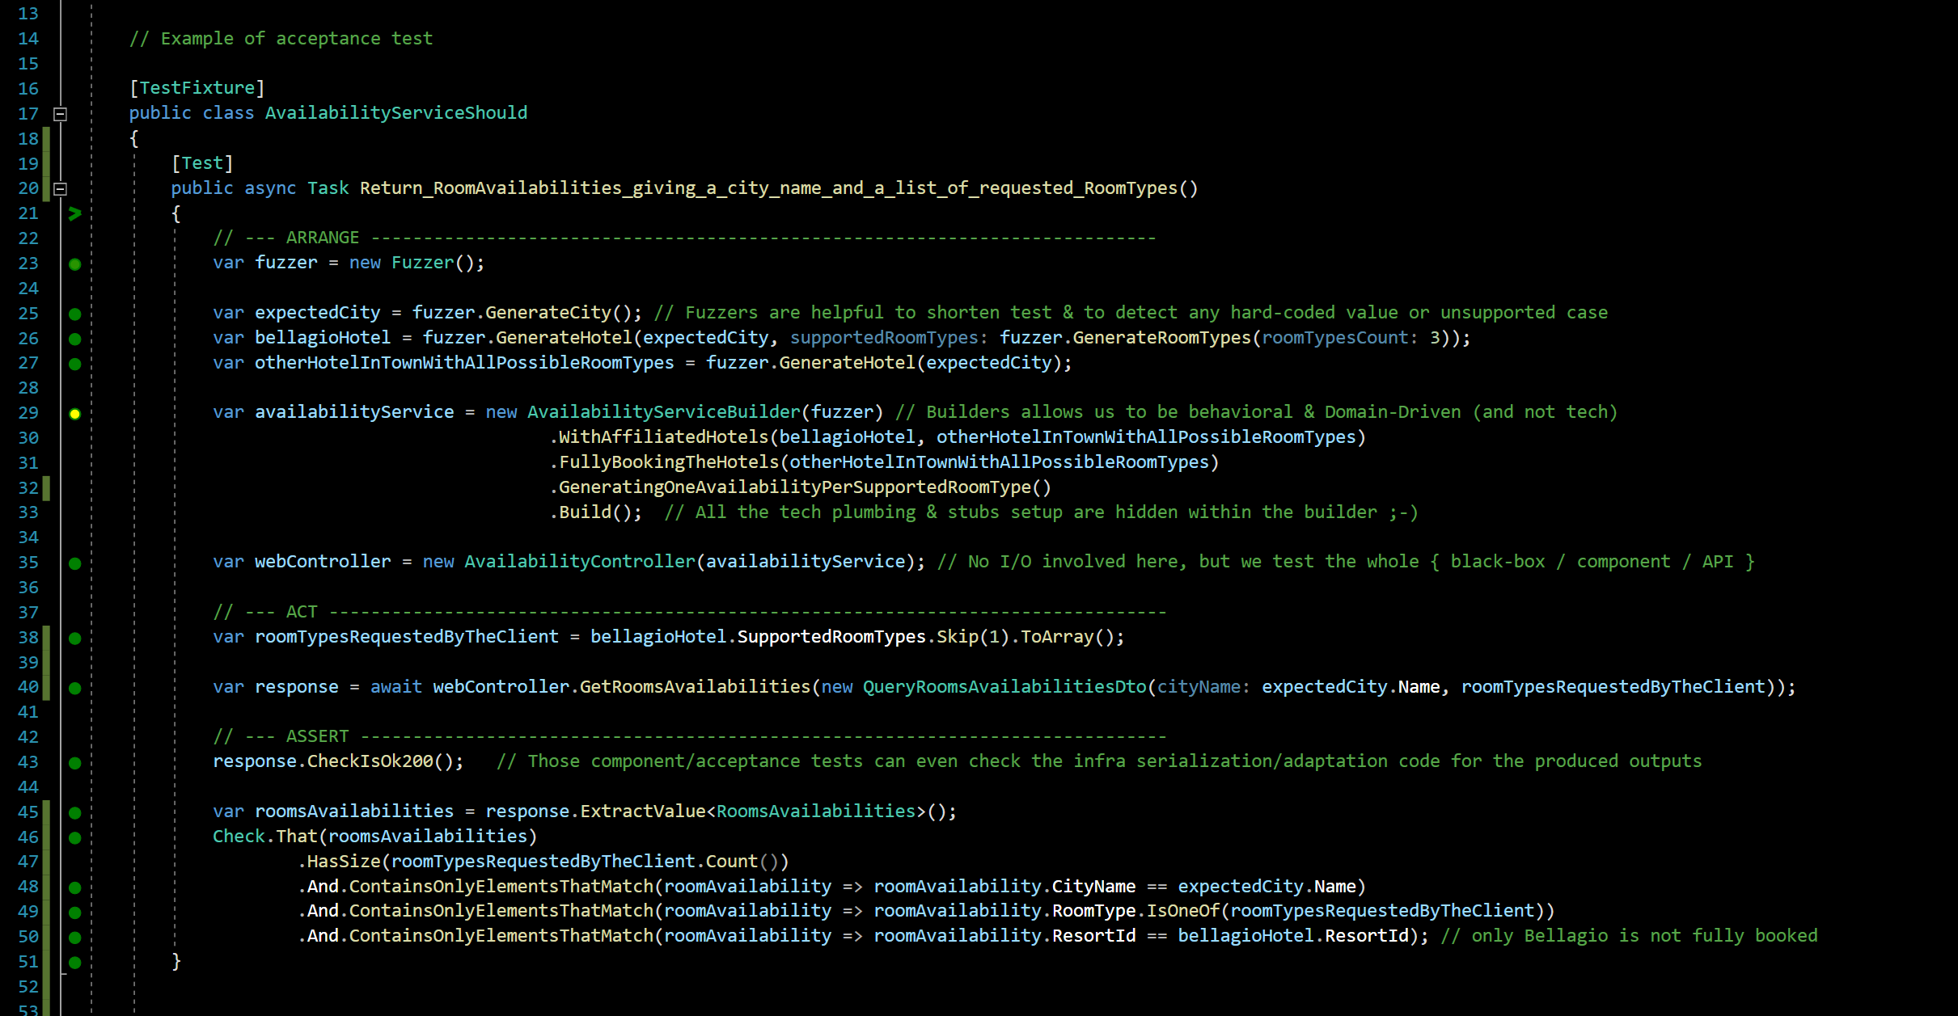
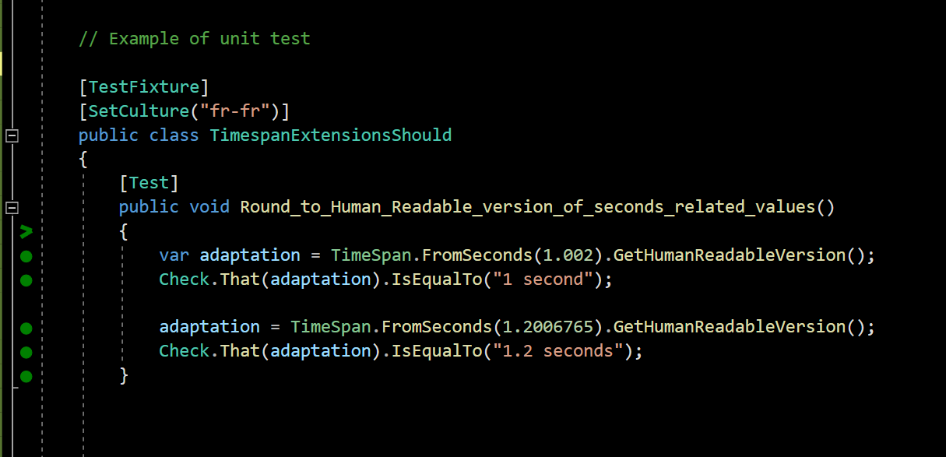
Can you Give me an example?
testing gem: Why outside-in diamond is now our favorite testing strategy @

Slide 102
What you test is what you ship…
No more bad surprises in situation >> everything is tested assembled
no more code plumbing leaks >> Our Acceptance tests cover everything (but I/O)
complementary contract (integration) tests >> A guarantee that the stubs we use to speed our Acceptance tests are faithful to reality
WHY
Easier for Junior DEVs
They are More focused on the system behaviors >> it Enforces Yagni
They code less fragile tests (no more implementation tests) >> it Eases merciless Refactoring
How
Specific Outside-in TDD
Double loop ➔ one and a half loop instead (Fine-grained unit tests only whenever facing difficulties)
Still Baby steps FTW!
only the external systems are stubbed
Acceptance tests cover adapters code too! (only the adaptation code in action, not its I/O)
Behavioural and domain-driven tests (DDD Ubiquitous language)
Blazing-fast acceptance tests
But…
…What about
Combinatory explosion of test cases?!? ➔lots of concise & easy to write acceptance tests (powered by fuzzers) were more than sufficient in 85% of our xp
Surgical identification of bug spots?!? ➔ no big deal actually. very episodically, You just debug your reproductible acceptance test and… TADA! (this point was just cargo-cult psychological barrier)
Friendly patterns & tools
DDD & Hexagonal architecture
Builders & Fuzzers for acceptance tests setup
live-testing tools
Dev people dislike to write enough integration tests (vs. unit ones). This explains lots of Blind Spots & Failures of classical test strategies
➔ We've tradeoff former approaches (UT x IT) in favor of safeness in production whatever the vigilance of the dev team
testing gem: Why outside-in diamond is now our favorite testing strategy @
Notes:
Blind spots of lots of test strategies is due to the fact that dev doesn’t take lot of time to code integration tests (vs. unit ones)
We trade off former approaches (UT x IT) in favor of quietness in production whatever the dev team.
Realizing that We realized that dev took more time to unit test than to integration tests
Dev dedicate a lot more times to unit test than integration tests

Slide 104
Test Driven
development
1. Fragile tests
2. Blind spots
3. Complex setups
Title here
THOMAS PIERRAIN (@TPIERRAIN)

Slide 105
Notes:
Image: https://miro.medium.com/max/7788/1*0aU36QSwzY0no7XEjoyM7g.jpeg

Slide 106
Notes:
Image: https://insights-images.thoughtworks.com/1020ways20pair20programming201_ac7561ab53c005c72dd42a76dcc238a9.png

Slide 107
Outside-in?
Test Driven
development
AT
AT
UT
UT
AT
AT
API
AT
UT
THOMAS PIERRAIN (@TPIERRAIN)
UT
Notes:
Image: https://miro.medium.com/max/13440/1*o7WmwGkLVR0dVQUYqfSBeg.jpeg

Slide 108
Test Driven
development
AT
AT
AT
AT
AT
AT
AT
AT
AT
AT
AT
AT
Domain
AT
AT
AT
100% covered
by Acceptance Tests
2.
Beware of… Blind Spots
Stub
BUG
IT
Right Adapter
Because integration tests are slow & boring ➔
IT
80%
IT
BUG
IT
THOMAS PIERRAIN (@TPIERRAIN)
HTTP
Left Adapter
80%
IT
API
IT
BUG
IT
Notes:
Image : https://insights-images.thoughtworks.com/pairprogramming_f0d3ae7ef121e981e150bfcae4ecb995.jpg

